Slide 1


EasyGraph
        Created by Bryan Josloff and Charlie Stoksik

Slide 2
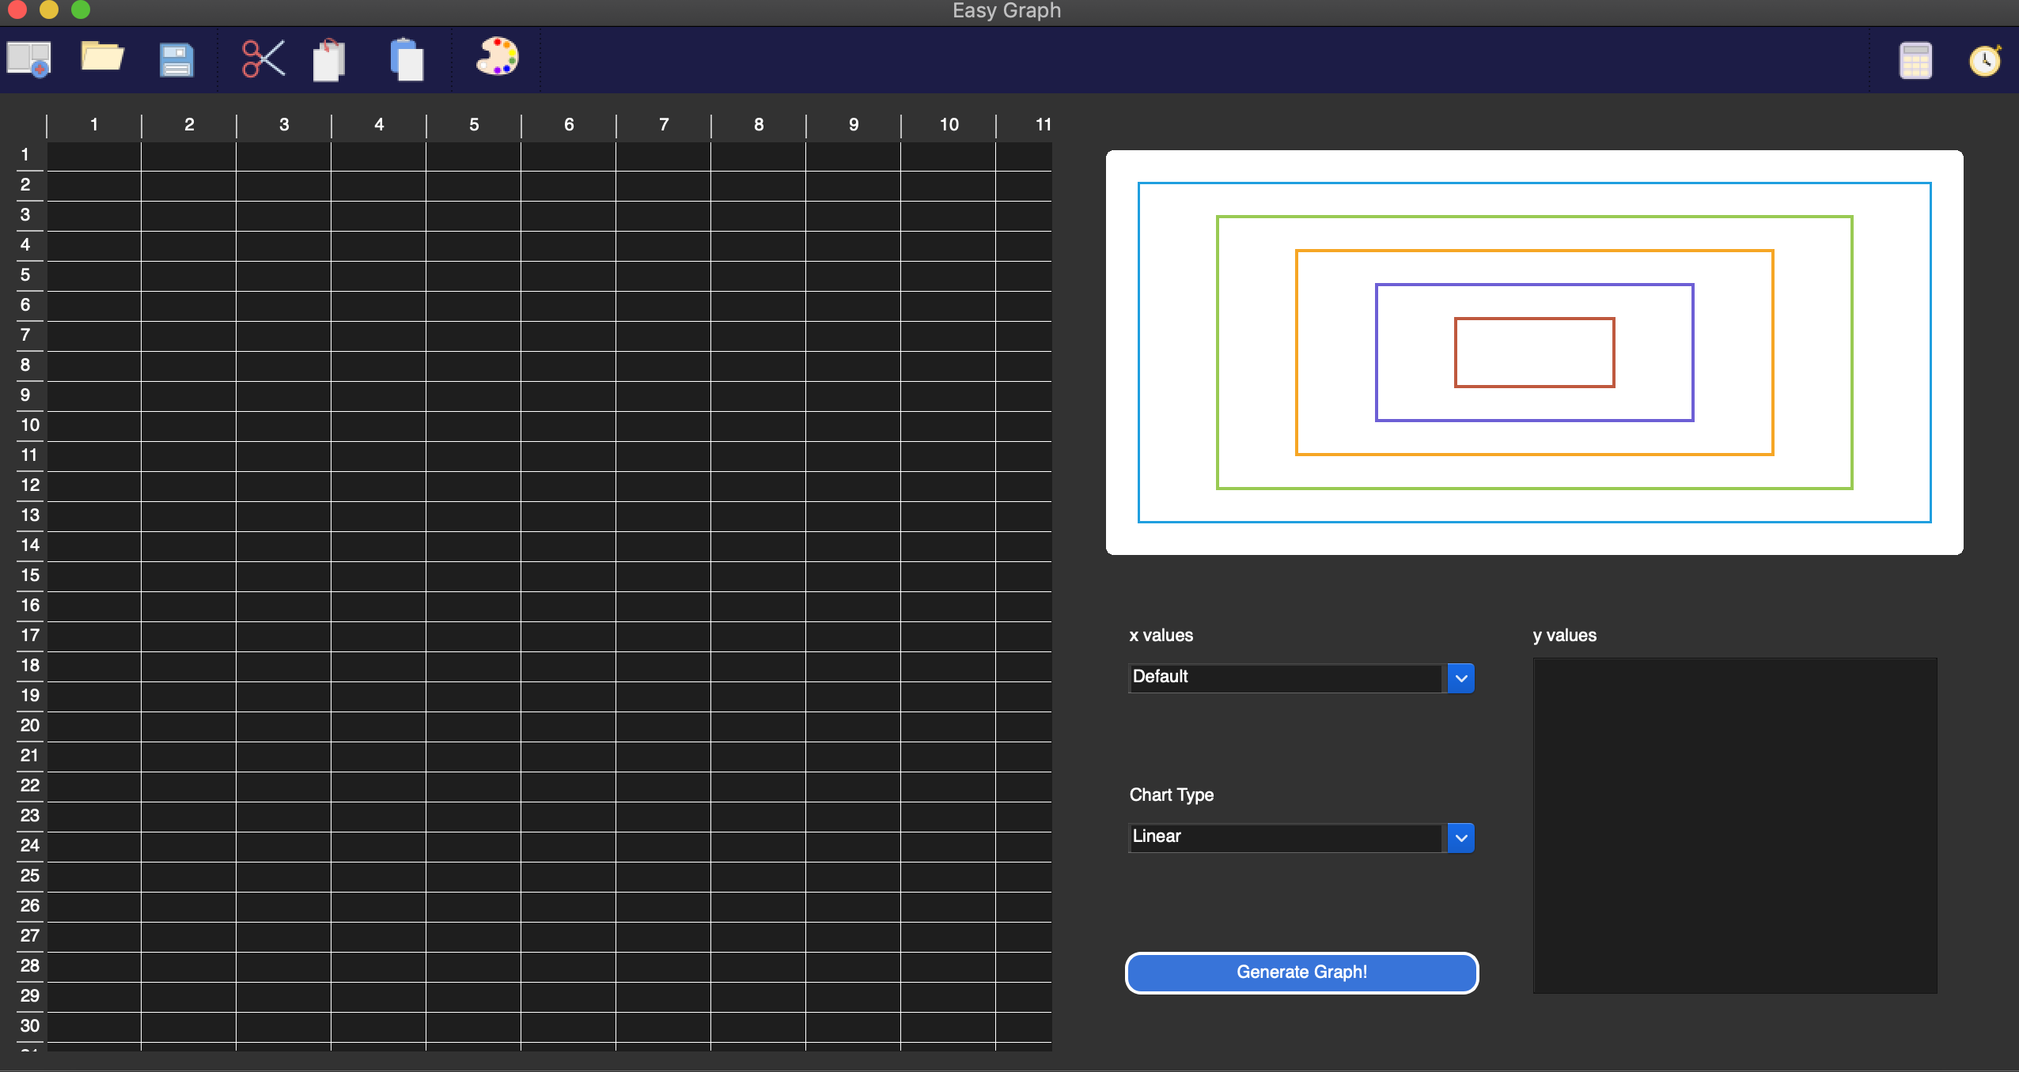
Goal: easier and more intuitive spreadsheet to graph application

Slide 3
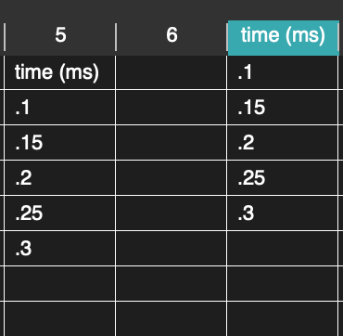
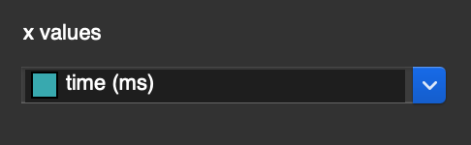
Premise: application tracks and organizes types of data for you

Slide 4

Class Hierarchy
QMainWindow
QMainWindow
QMainWindow
MainWindow
Table
Chart

Slide 5

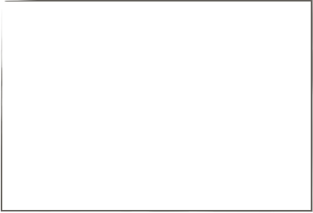
MainWindow
UI Stuff
Operations
QAction
QMenu
QComboBox
QPushButton
QAction
QMenu
QComboBox
QListWidget
QAction
QMenu
QVBoxLayout
QAction
QMenu
QAction
QMenu
QAction
QMenu

Slide 6

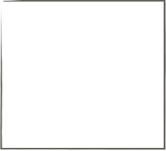
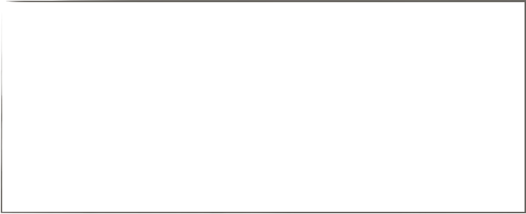
Table
QTableWidget
TableWidgetItem
key_functor
MyQTable
QTableHeaderWidget
QHeaderView
col_functor
QDialog
QCheckBox
PopUpWindow
QCheckBox
MyQCheckBox
QColorDialog
MyQColorCheckBox

Slide 7
Chart
QChartView
QChart

Slide 8

The Logic

